Slide 1

activity Tracker app
By: Ryan Lindsey

Slide 2

The idea
Where Did The Idea Come From?
How Does The App Work?
How Can It Help You?

Slide 3

The Technical
Login/Signup Implementation
Home Page
Sessions Page
Statistics Page
Inspiration Page
Backend Implementation

Slide 4

Login/signup

Slide 5
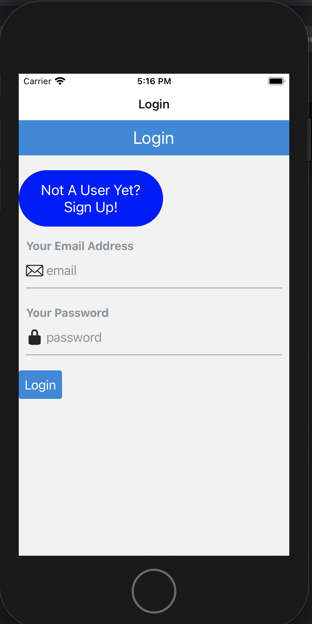
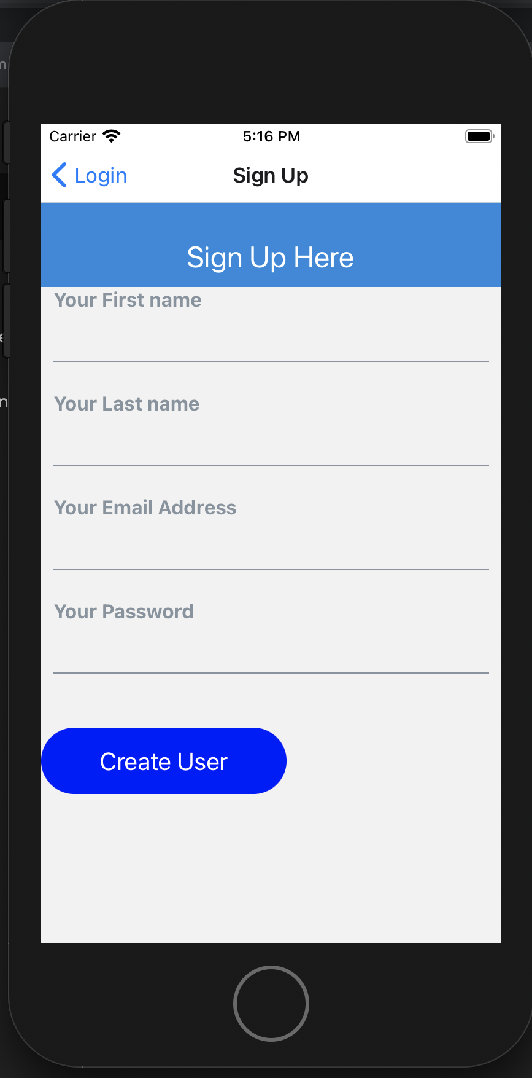

Slide 6
Minor Points
React Native Elements
Used Touchable Opacity for Buttons instead
Managed state within the Components
Simple interface

Slide 7
Welcome home
Explanation of the explanation

Slide 8
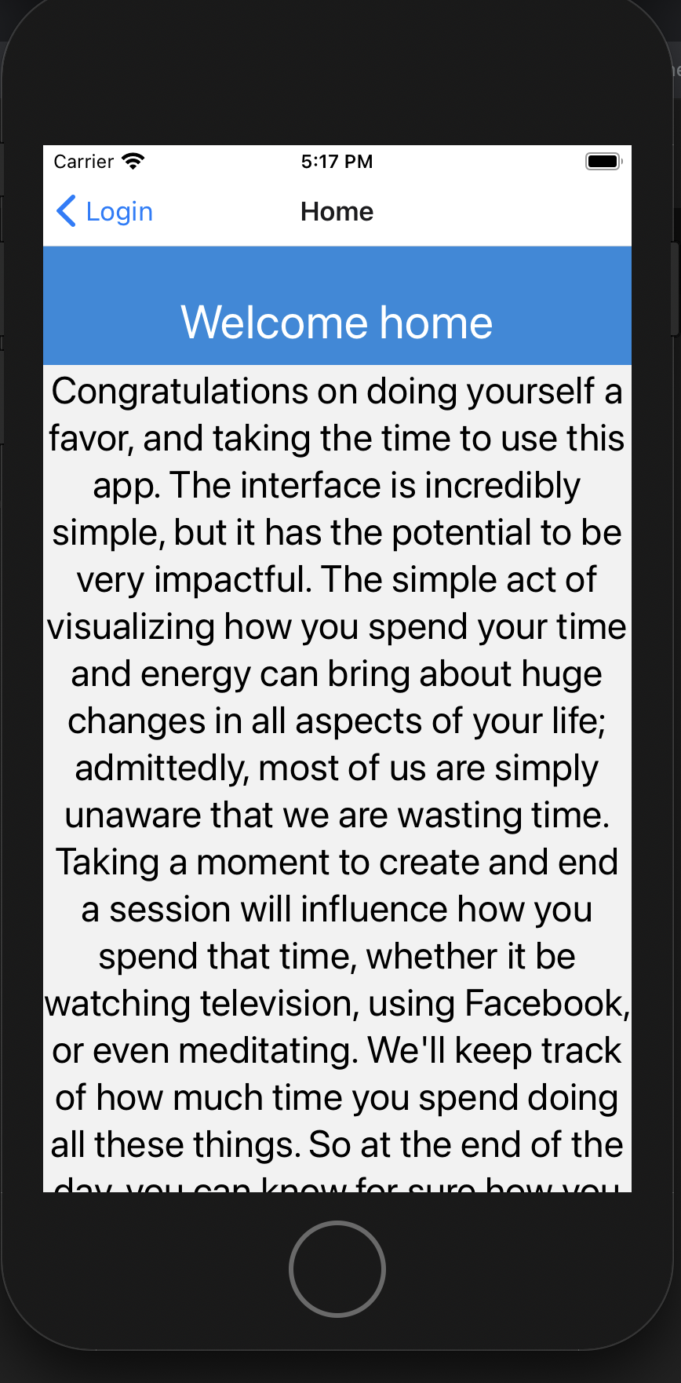

Slide 9

Which Route to take?

Slide 10
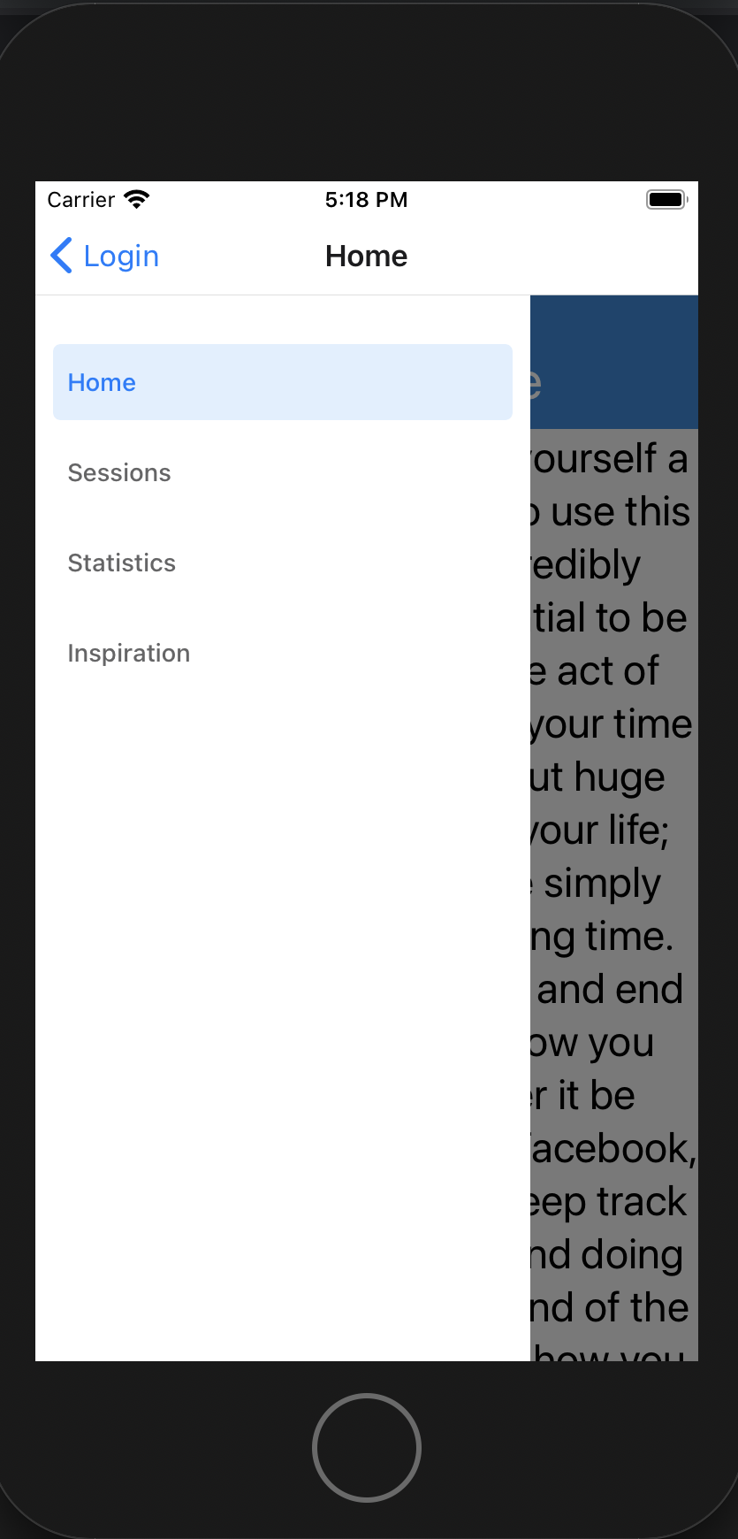
Why use drawer navigation?
What could I have done better?

Slide 11

Sessions

Slide 12
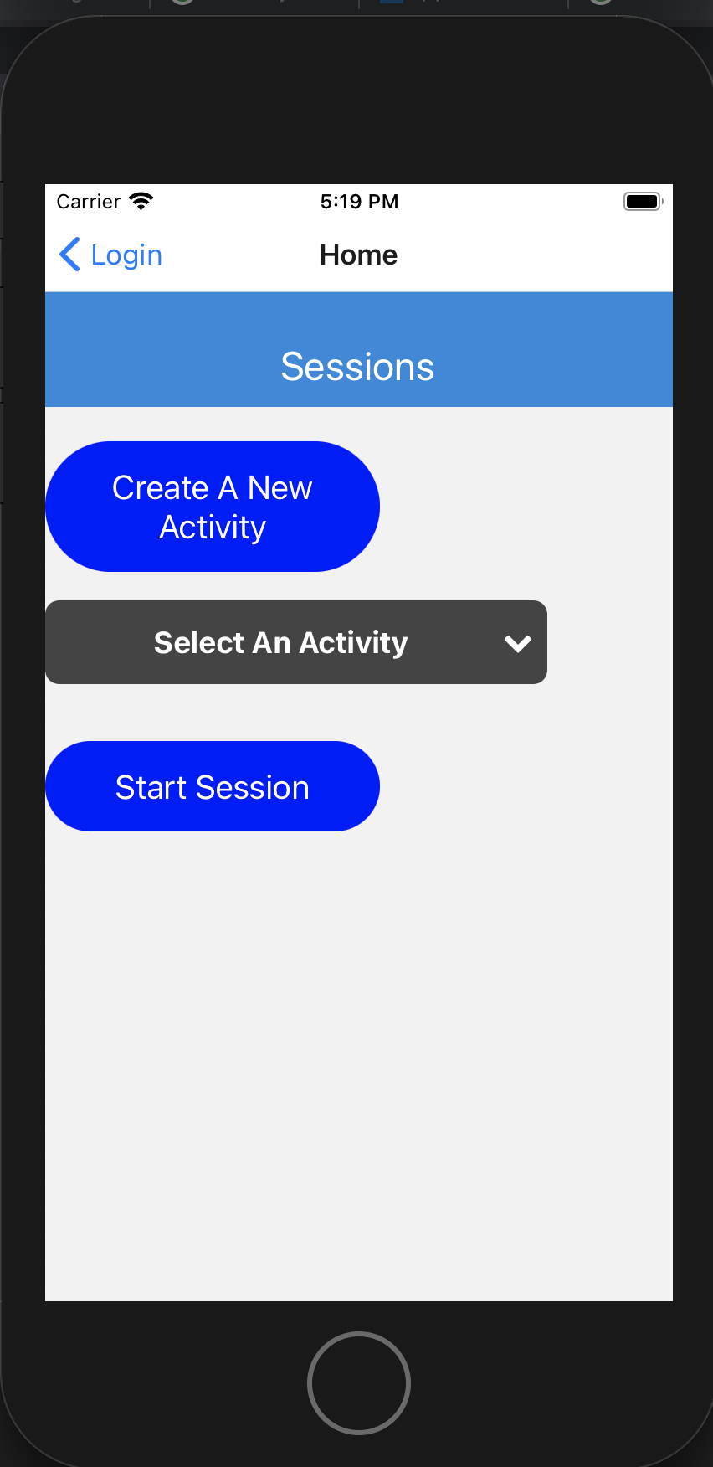

Slide 13
Sessions Page explained
What are activities?
How to create a session?
What happens when a session is created?
From Tech Tracker to Activity Tracker

Slide 14

Statistics

Slide 15
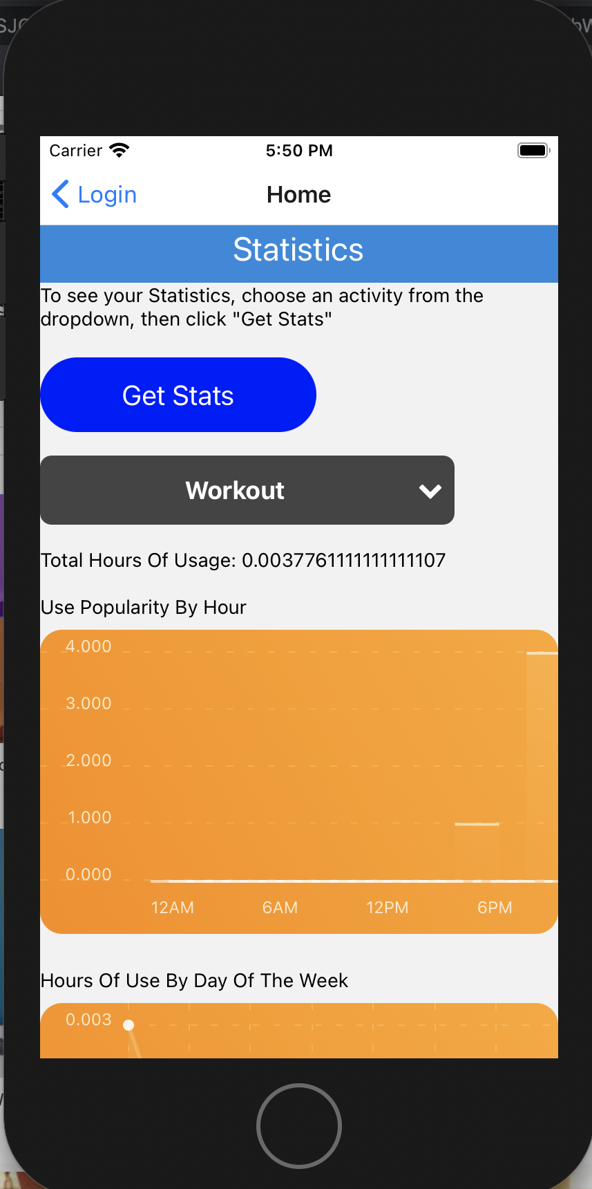

Slide 16
Statistics explained
Wanted to incorporate data visualization
How are the statistics generated?
What are we measuring?
React Native Chart Kits vs Plotly.js
Troubleshooting the chart errors

Slide 17
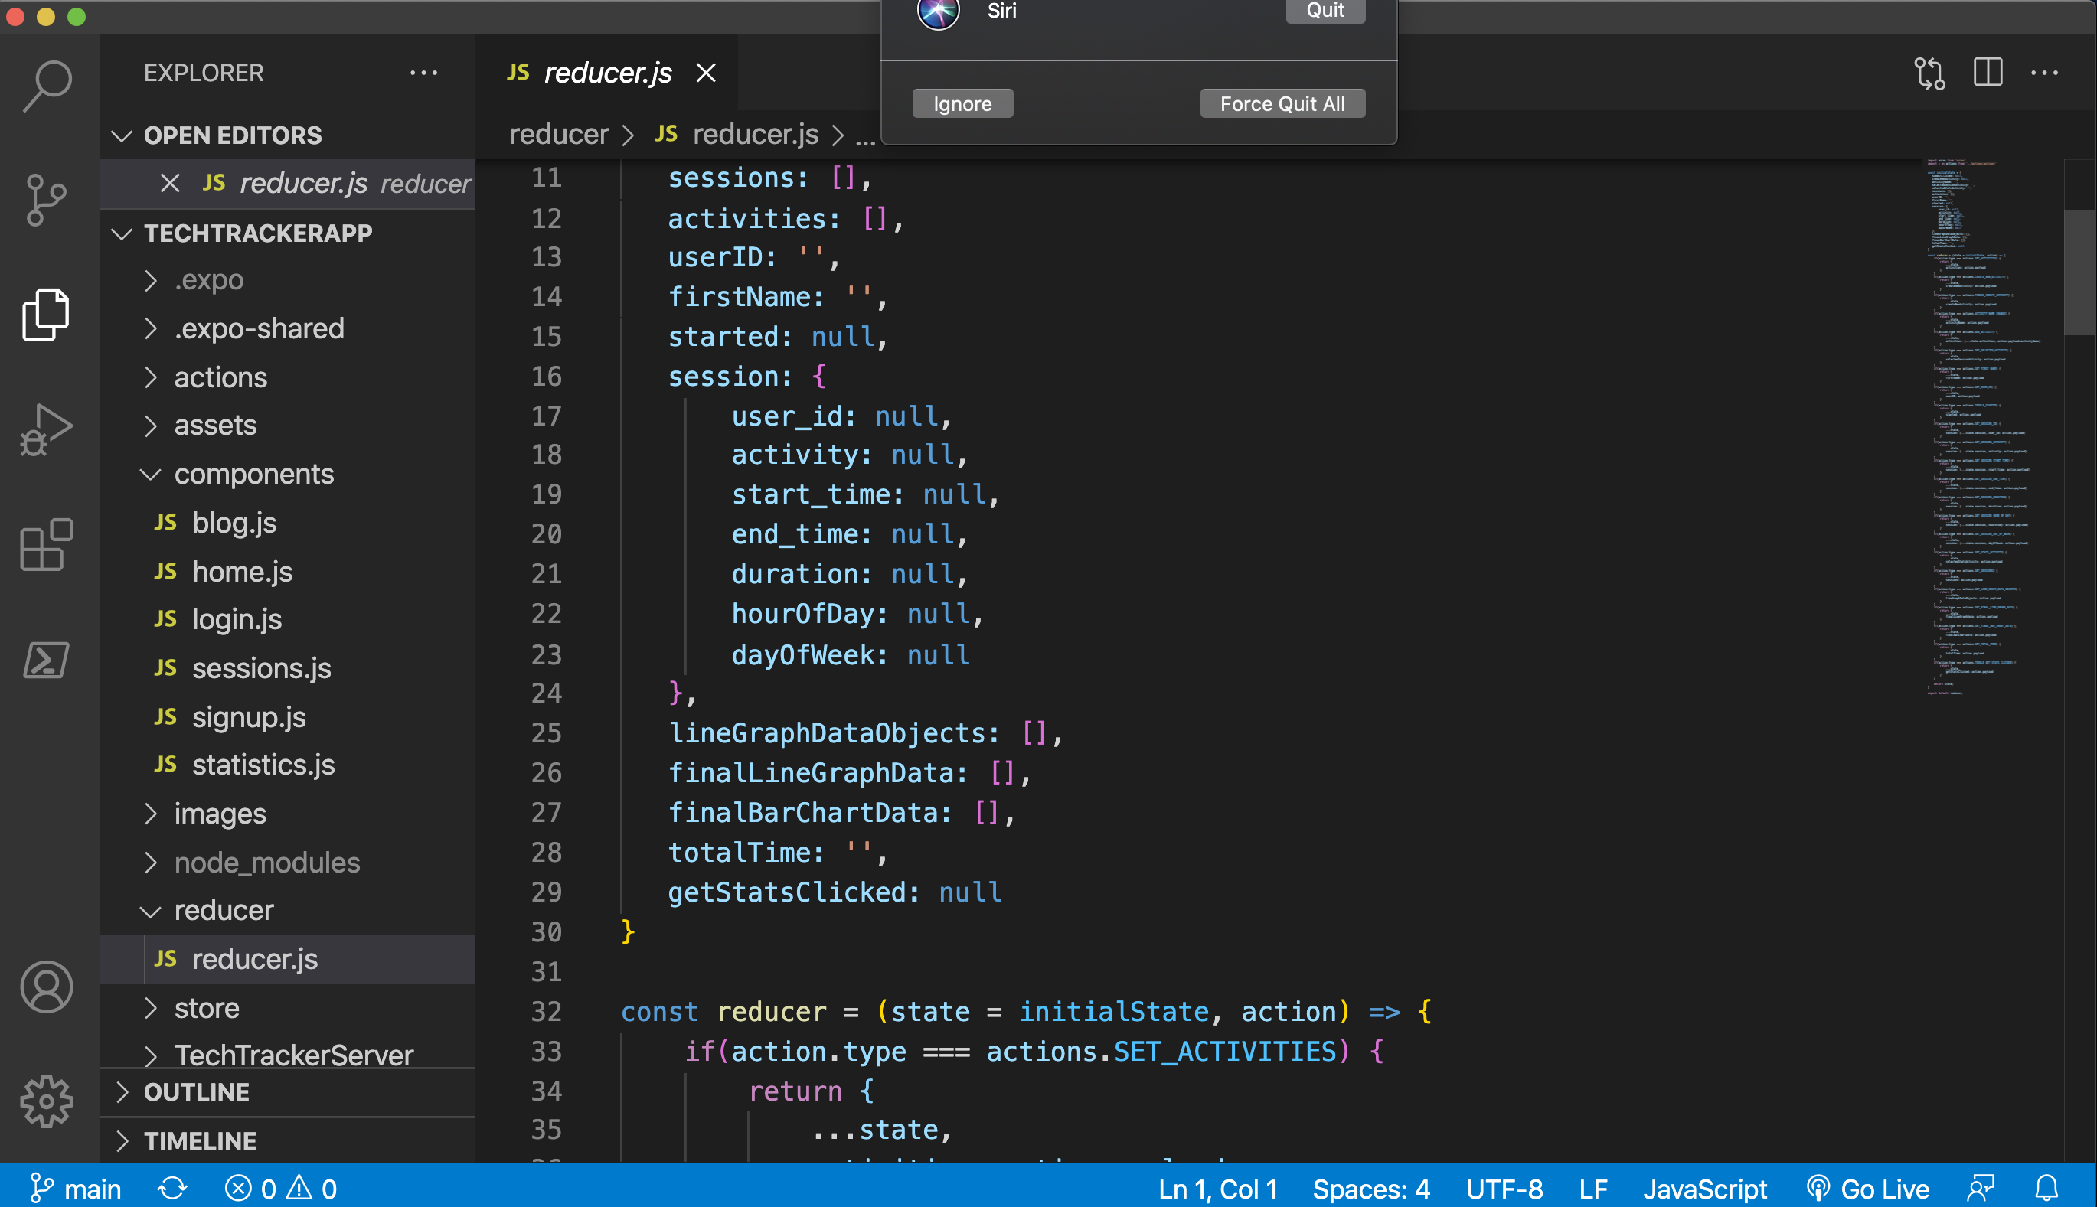
FROM this…

Slide 18
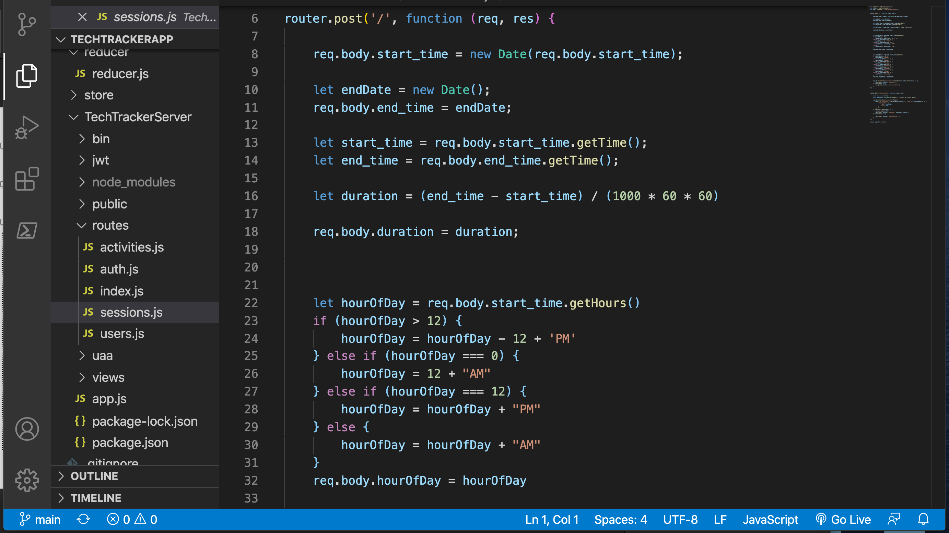
To this…

Slide 19
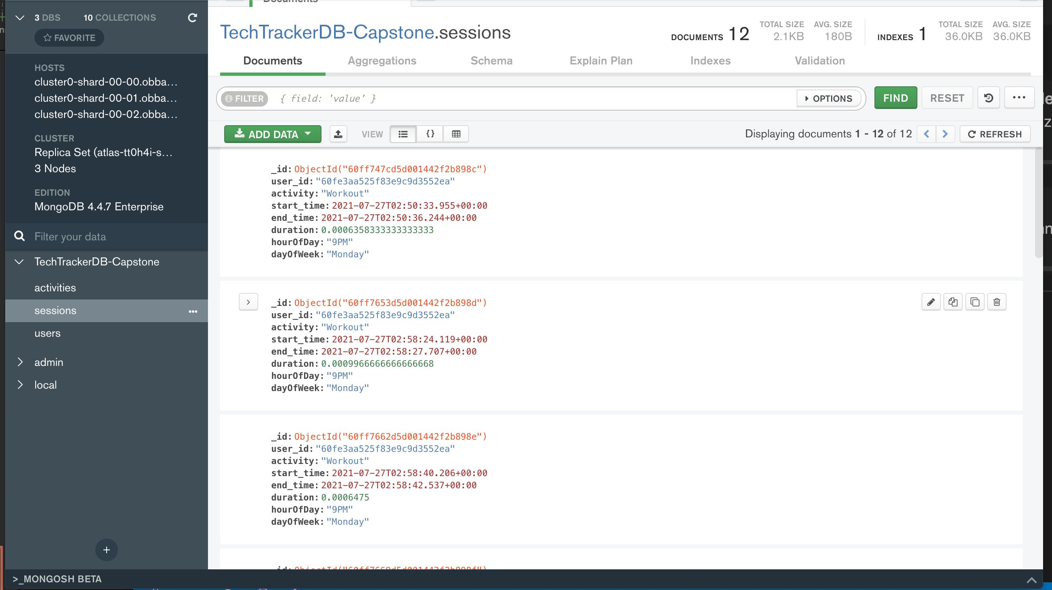
To This…

Slide 20
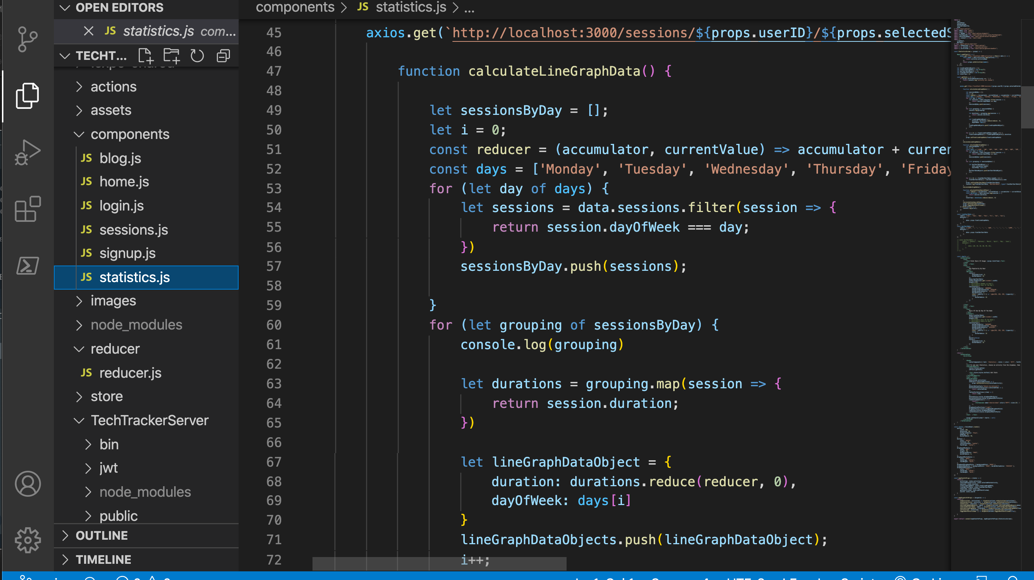
To THIS…

Slide 21
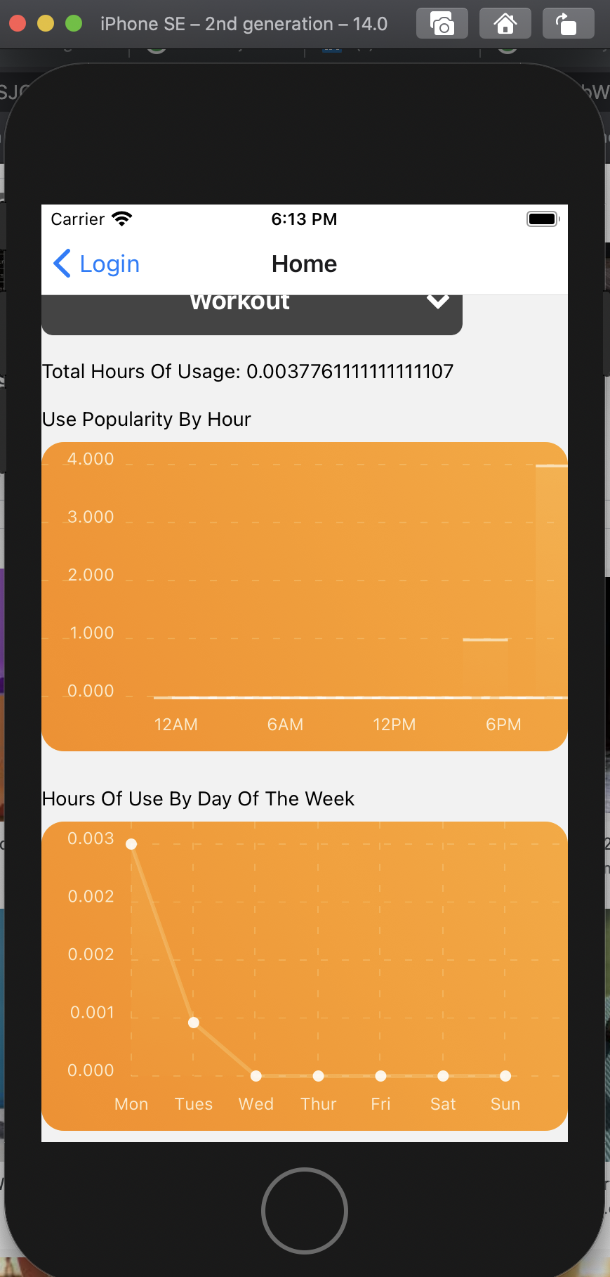
And finally to our charts

Slide 22

inspiration

Slide 23
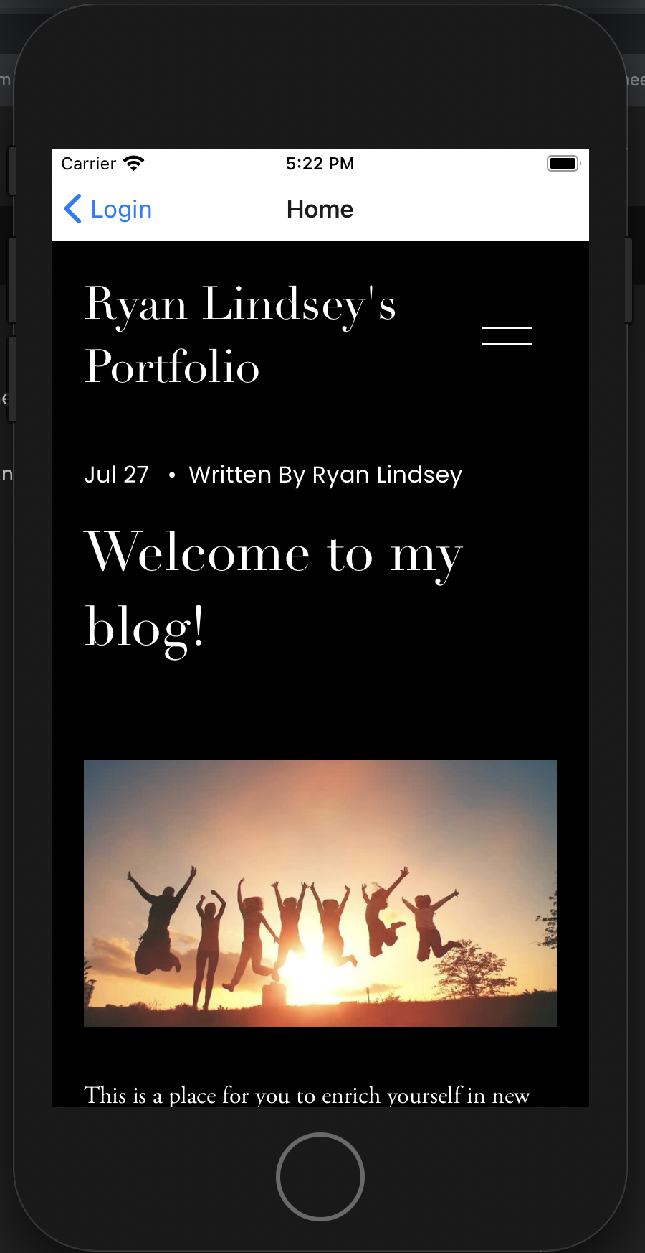
What is this page?
Simple Web View Of My Blog
To Stimulate Curious Minds

Slide 24

The Backend and state management

Slide 25
How did I manage these?
Database Used?
Where was my state held?
What advantages vs disadvantages did this pose for me?

Slide 26

Challenges and what I would have done differently
Understanding the re-render process in Redux
Take Asaad’s advice on isolating the problem to avoid overwhelm.
If there were more time, made the application more interactive.

Slide 27

That’s all folks!

